Slide 1
CSE7302- University Project Review-4
Smart Traffic Management System for Urban Congestion
Under the Supervision of,
Batch Number: CSE_14
Guide – MS. Kummara Sruthi (Assistant Professor)
School of Computer Science and Engineering
Presidency University
Name of the Program: School Of Computer Science & Engineering
Name of the HoD: Dr. Asif Mohammed, Dr. Blessed Prince
Name of the Program Project Coordinator: Dr. Jayavadivel Ravi, Mr. Muthuraju V
Name of the School Project Coordinators: Dr. Sampath A K , Dr. Geetha A
Roll Number | Student Name
20221CSE0234 | Syed Thousif
20221CSE0217 | Gajjula Ashok Kumar Reddy
20221CSE0211 | Kambam Nithin Kumar Reddy

Slide 2
Concentrate On These
80% Report Softcopy Submission-Draft (Abstract, Literature Review, System Design. Architecture, Algorithm Details Module Description)
100% IEEE paper Should Be Done

Slide 3
Content
Objectives
Technology Stack
System Architecture
Key Features
Code Structure
Database Design
User Interface
Results & Performance
Conclusion
Github Link
References (IEEE Paper format)

Slide 4
Objectives
Develop an AI-based traffic congestion prediction system using machine learning.
Implement smart parking detection using computer vision techniques.
Improve traffic signal control through intelligent congestion analysis.
Provide real-time traffic updates and parking availability to users.
Support emergency vehicle prioritization for faster response.

Slide 5
Technology Stack
Programming & Framework
Python
Flask (Web Framework)
Machine Learning
Random Forest Algorithm
Scikit-learn, NumPy, Pandas
Computer Vision
OpenCV
Frontend
HTML, CSS, JavaScript
Tools
VS Code, GitHub

Slide 6
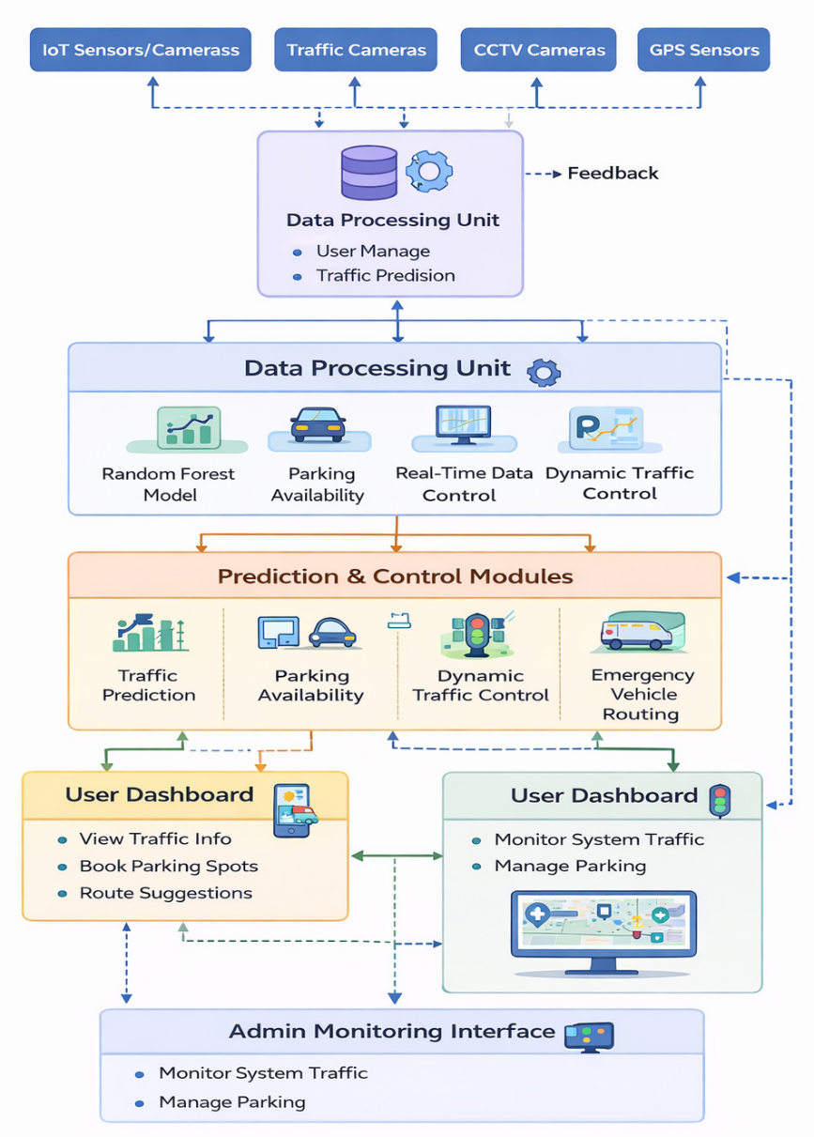
System Architecture
Data collected from IoT sensors, traffic cameras, GPS, and historical datasets.
Data preprocessing and feature extraction in the processing layer.
Random Forest model predicts traffic congestion levels.
Computer vision module detects available parking slots.
Results displayed through user dashboard and admin monitoring interface.

Slide 7
Key Features
Real-time traffic congestion prediction.
Smart parking slot detection using computer vision.
Dynamic traffic signal optimization.
Emergency vehicle routing and signal priority.
Real-time monitoring through dashboard interface.

Slide 8
Code Structure
Main File
Project.py – Contains routes, ML model loading, and system logic.
Flask Routes
/register, /login, /logout – user management
/ – main dashboard
/predict – traffic congestion prediction
/parking_status – parking slot detection
Core Functions
predict_congestion()
detect_parking_slots()
optimize_signal()

Slide 9
Database Design
The system database stores traffic data, user information, and prediction history.
Tables / Collections
1. Users – login credentials and profile information
2.Traffic Data – vehicle count, speed, queue length
3. Parking Status – slot availability and occupancy
4. Prediction History – previous traffic predictions and analysis results
This structure supports efficient storage and retrieval of real-time traffic data.

Slide 10
User Interface
Interactive dashboard showing traffic conditions.
Displays available parking slots in real time.
Provides route suggestions based on congestion prediction.
Admin interface for traffic monitoring and parking management.
Designed using HTML, CSS, and JavaScript for responsive interaction.

Slide 11
Results & Performance
Improved traffic flow efficiency and reduced congestion levels.
Increase in average vehicle speed after system implementation.
Reduction in vehicle queue length at intersections.
Decrease in CO₂ emissions due to optimized traffic flow.
Machine learning model achieved high prediction accuracy for congestion detection.

Slide 12
Conclusion
The proposed Smart AI-Based Traffic and Parking Management System provides an intelligent solution for urban traffic challenges. By integrating machine learning and computer vision techniques, the system improves traffic prediction accuracy, optimizes signal control, and enhances parking utilization. The results demonstrate its potential to support efficient transportation management and smart city infrastructure.

Slide 13
Github Link
Project Source Code:
GitHub Repository https://github.com/SThousif/Smart-Traffic-Management-System-for-Urban-Congestion
Includes:
Source code
Dataset
Model files
Documentation

Slide 14
References (IEEE Paper format)
[1] Y. Kim, H. Lee, and J. Park, “Deep learning–based adaptive traffic signal control for large-scale urban networks,” IEEE Access, 2026.
[2] S. Rahman and M. Hossain, “Smart traffic congestion prediction using artificial intelligence and IoT,” IEEE Open Journal of Intelligent Transportation Systems, 2026.
[3] M. Rajagopal, R. Sivasakthivel, and G. Anitha, “An intelligent transportation system for traffic flow prediction using graph neural networks,” IEEE Transactions on Intelligent Transportation Systems, 2025.
[4] Y. Huang, Y. Dong, Y. Tang, and L. Li, “Parking availability prediction via fusing multi-source data with a self-supervised learning enhanced spatio-temporal transformer,” IEEE Transactions on Intelligent Transportation Systems, 2025.
[5] C. Zhang, J. Wang, and Y. Liu, “Real-time traffic flow prediction using random forest and sensor data fusion,” IEEE Access, 2025.
[6] S. Alam, M. Luqman, and S. Ali, “Multi-source data-driven traffic congestion detection using artificial intelligence,” IEEE Access, 2025.
[7] R. Abduljabbar, H. Dia, and S. Liyanage, “Machine learning–based traffic flow prediction models for smart and sustainable traffic management,” IEEE Open Journal of Intelligent Transportation Systems, 2024.
[8] A. Rahmani, A. Al-Fuqaha, and M. Guizani, “AI-enabled intelligent traffic signal management for smart cities,” IEEE Access, 2024.

Slide 15
References (IEEE Paper format)
[9] T. Bouraffa, E. Wessman, and A. Nouri, “Vision-based traffic event detection using deep learning,” in Proc. IEEE International Conference on Intelligent Transportation Systems (ITSC), 2024.
[10] L. Falaschetti et al., “Embedded real-time vehicle detection for intelligent traffic control systems,” IEEE Transactions on Intelligent Transportation Systems, 2024.
[11] H. Li, X. Pang, and Z. Chen, “Graph neural networks in intelligent transportation systems: A survey,” IEEE Transactions on Intelligent Transportation Systems, 2023.
[12] W. Wang, R. Patel, and S. Rao, “Reinforcement learning for adaptive traffic signal optimization,” IEEE Intelligent Systems, 2023.
[13] J. Chen, X. Li, and W. Zhang, “Vehicle prioritization using deep learning for real-time traffic signals,” IEEE Transactions on Intelligent Transportation Systems, 2023.
[14] A. Das, S. Roy, and P. Kumar, “Deep learning–based traffic anomaly detection for intelligent transportation systems,” in Proc. IEEE International Conference on Machine Learning and Applications (ICMLA), 2023.
[15] Y. Lv, Y. Duan, W. Kang, Z. Li, and F.-Y. Wang, “Traffic flow prediction with big data: A deep learning approach,” IEEE Transactions on Intelligent Transportation Systems, 2023.

Slide 16


